Slide 1

Pandas
P Y T H O N
Zakaria Ahmed
Omar Mohsen
Bassant Adel

Slide 2
brics
pandas pd
brics = pd.read_csv("path/to/brics.csv", index_col = 0) brics
 | country | capital | area | population
BR | Brazil | Brasilia | 8.516 | 200.40
RU | Russia | Moscow | 17.100 | 143.50
IN | India | New Delhi | 3.286 | 1252.00
CH | China | Beijing | 9.597 | 1357.00
SA | South Africa | Pretoria | 1.221 | 52.98

Slide 3
Index and select data
Square brackets
Advanced methods loc
iloc

Slide 4
Column Access [ ]
 | country | capital | area | population
BR | Brazil | Brasilia | 8.516 | 200.40
RU | Russia | Moscow | 17.100 | 143.50
IN | India | New Delhi | 3.286 | 1252.00
CH | China | Beijing | 9.597 | 1357.00
SA | South Africa | Pretoria | 1.221 | 52.98
brics["country"]
BR RU IN CH SA
Brazil Russia India China
South Africa
Name: country, dtype: object

Slide 5
Column Access [ ]
 | country | capital | area | population
BR | Brazil | Brasilia | 8.516 | 200.40
RU | Russia | Moscow | 17.100 | 143.50
IN | India | New Delhi | 3.286 | 1252.00
CH | China | Beijing | 9.597 | 1357.00
SA | South Africa | Pretoria | 1.221 | 52.98
type(brics["country"])
pandas.core.series.Series
1D labelled array

Slide 6
Column Access [ ]
 | country | capital | area | population
BR | Brazil | Brasilia | 8.516 | 200.40
RU | Russia | Moscow | 17.100 | 143.50
IN | India | New Delhi | 3.286 | 1252.00
CH | China | Beijing | 9.597 | 1357.00
SA | South Africa | Pretoria | 1.221 | 52.98
brics[["country"]]
 | country
BR | Brazil
RU | Russia
IN | India
CH | China
SA | South Africa

Slide 7
Column Access [ ]
 | country | capital | area | population
BR | Brazil | Brasilia | 8.516 | 200.40
RU | Russia | Moscow | 17.100 | 143.50
IN | India | New Delhi | 3.286 | 1252.00
CH | China | Beijing | 9.597 | 1357.00
SA | South Africa | Pretoria | 1.221 | 52.98
type(brics[["country"]])
pandas.core.frame.DataFrame

Slide 8
Column Access [ ]
 | country | capital | area | population
BR | Brazil | Brasilia | 8.516 | 200.40
RU | Russia | Moscow | 17.100 | 143.50
IN | India | New Delhi | 3.286 | 1252.00
CH | China | Beijing | 9.597 | 1357.00
SA | South Africa | Pretoria | 1.221 | 52.98
brics[["country", "capital"]]
 | country | capital
BR | Brazil | Brasilia
RU | Russia | Moscow
IN | India | New Delhi
CH | China | Beijing
SA | South Africa | Pretoria

Slide 9
Row Access [ ]
 | country | capital | area | population
BR | Brazil | Brasilia | 8.516 | 200.40
RU | Russia | Moscow | 17.100 | 143.50
IN | India | New Delhi | 3.286 | 1252.00
CH | China | Beijing | 9.597 | 1357.00
SA | South Africa | Pretoria | 1.221 | 52.98
brics[1:4]
 | country | capital | area | population
RU | Russia | Moscow | 17.100 | 143.5
IN | India | New Delhi | 3.286 | 1252.0
CH | China | Beijing | 9.597 | 1357.0

Slide 10
Row Access [ ]
 | country | capital | area | population
BR | Brazil | Brasilia | 8.516 | 200.40 | * 0 | *
RU | Russia | Moscow | 17.100 | 143.50 | * 1 | *
IN | India | New Delhi | 3.286 | 1252.00 | * 2 | *
CH | China | Beijing | 9.597 | 1357.00 | * 3 | *
SA | South Africa | Pretoria | 1.221 | 52.98 | * 4 | *
brics[1:4]
 | country | capital | area | population
RU | Russia | Moscow | 17.100 | 143.5
IN | India | New Delhi | 3.286 | 1252.0
CH | China | Beijing | 9.597 | 1357.0

Slide 11
Discussion [ ]
Square brackets: limited functionality
Ideally
2D NumPy arrays
my_array[rows, columns]
pandas
loc (label-based)
iloc (integer position-based)

Slide 12
Row Access loc
 | country | capital | area | population
BR | Brazil | Brasilia | 8.516 | 200.40
RU | Russia | Moscow | 17.100 | 143.50
IN | India | New Delhi | 3.286 | 1252.00
CH | China | Beijing | 9.597 | 1357.00
SA | South Africa | Pretoria | 1.221 | 52.98
brics.loc["RU"]
country capital area population
Russia Moscow
17.1
143.5
Name: RU, dtype: object
Row as pandas Series

Slide 13
Row Access loc
 | country | capital | area | population
BR | Brazil | Brasilia | 8.516 | 200.40
RU | Russia | Moscow | 17.100 | 143.50
IN | India | New Delhi | 3.286 | 1252.00
CH | China | Beijing | 9.597 | 1357.00
SA | South Africa | Pretoria | 1.221 | 52.98
brics.loc[["RU"]]
country capital area population RU Russia Moscow 17.1 143.5
DataFrame

Slide 14
Row Access loc
 | country | capital | area | population
BR | Brazil | Brasilia | 8.516 | 200.40
RU | Russia | Moscow | 17.100 | 143.50
IN | India | New Delhi | 3.286 | 1252.00
CH | China | Beijing | 9.597 | 1357.00
SA | South Africa | Pretoria | 1.221 | 52.98
brics.loc[["RU", "IN", "CH"]]
 | country | capital | area | population
RU | Russia | Moscow | 17.100 | 143.5
IN | India | New Delhi | 3.286 | 1252.0
CH | China | Beijing | 9.597 | 1357.0

Slide 15
Row & Column loc
 | country | capital | area | population
BR | Brazil | Brasilia | 8.516 | 200.40
RU | Russia | Moscow | 17.100 | 143.50
IN | India | New Delhi | 3.286 | 1252.00
CH | China | Beijing | 9.597 | 1357.00
SA | South Africa | Pretoria | 1.221 | 52.98
brics.loc[["RU", "IN", "CH"], ["country", "capital"]]
 | country | capital
RU | Russia | Moscow
IN | India | New Delhi
CH | China | Beijing

Slide 16
Row & Column loc
 | country | capital | area | population
BR | Brazil | Brasilia | 8.516 | 200.40
RU | Russia | Moscow | 17.100 | 143.50
IN | India | New Delhi | 3.286 | 1252.00
CH | China | Beijing | 9.597 | 1357.00
SA | South Africa | Pretoria | 1.221 | 52.98
brics.loc[:, ["country", "capital"]]
 | country | capital
BR | Brazil | Brasilia
RU | Russia | Moscow
IN | India | New Delhi
CH | China | Beijing
SA | South Africa | Pretoria

Slide 17
Recap
Square brackets
Column access brics[["country", "capital"]]
Row access: only through slicing brics[1:4]
loc (label-based)
Row access brics.loc[["RU", "IN", "CH"]]
Column access brics.loc[:, ["country", "capital"]]
Row & Column access
brics.loc[
["RU", "IN", "CH"],
["country", "capital"]
]

Slide 18
Row Access iloc
 | country | capital | area | population
BR | Brazil | Brasilia | 8.516 | 200.40
RU | Russia | Moscow | 17.100 | 143.50
IN | India | New Delhi | 3.286 | 1252.00
CH | China | Beijing | 9.597 | 1357.00
SA | South Africa | Pretoria | 1.221 | 52.98
brics.loc[["RU"]]
 | country capital | area | population
RU | Russia Moscow | 17.1 | 143.5
brics.iloc[[1]]
 | country capital | area | population
RU | Russia Moscow | 17.1 | 143.5

Slide 19
Row Access iloc
 | country | capital | area | population
BR | Brazil | Brasilia | 8.516 | 200.40
RU | Russia | Moscow | 17.100 | 143.50
IN | India | New Delhi | 3.286 | 1252.00
CH | China | Beijing | 9.597 | 1357.00
SA | South Africa | Pretoria | 1.221 | 52.98
brics.loc[["RU", "IN", "CH"]]
 | country | capital | area | population
RU | Russia | Moscow | 17.100 | 143.5
IN | India | New Delhi | 3.286 | 1252.0
CH | China | Beijing | 9.597 | 1357.0

Slide 20
Row Access iloc
 | country | capital | area | population
BR | Brazil | Brasilia | 8.516 | 200.40
RU | Russia | Moscow | 17.100 | 143.50
IN | India | New Delhi | 3.286 | 1252.00
CH | China | Beijing | 9.597 | 1357.00
SA | South Africa | Pretoria | 1.221 | 52.98
brics.iloc[[1,2,3]]
 | country | capital | area | population
RU | Russia | Moscow | 17.100 | 143.5
IN | India | New Delhi | 3.286 | 1252.0
CH | China | Beijing | 9.597 | 1357.0

Slide 21
Row & Column iloc
 | country | capital | area | population
BR | Brazil | Brasilia | 8.516 | 200.40
RU | Russia | Moscow | 17.100 | 143.50
IN | India | New Delhi | 3.286 | 1252.00
CH | China | Beijing | 9.597 | 1357.00
SA | South Africa | Pretoria | 1.221 | 52.98
brics.loc[["RU", "IN", "CH"], ["country", "capital"]]
 | country | capital
RU | Russia | Moscow
IN | India | New Delhi
CH | China | Beijing

Slide 22
Row & Column iloc
 | country | capital | area | population
BR | Brazil | Brasilia | 8.516 | 200.40
RU | Russia | Moscow | 17.100 | 143.50
IN | India | New Delhi | 3.286 | 1252.00
CH | China | Beijing | 9.597 | 1357.00
SA | South Africa | Pretoria | 1.221 | 52.98
brics.iloc[[1,2,3], [0, 1]]
 | country | capital
RU | Russia | Moscow
IN | India | New Delhi
CH | China | Beijing

Slide 23
Row & Column iloc
 | country | capital | area | population
BR | Brazil | Brasilia | 8.516 | 200.40
RU | Russia | Moscow | 17.100 | 143.50
IN | India | New Delhi | 3.286 | 1252.00
CH | China | Beijing | 9.597 | 1357.00
SA | South Africa | Pretoria | 1.221 | 52.98
brics.loc[:, ["country", "capital"]]
 | country | capital
BR | Brazil | Brasilia
RU | Russia | Moscow
IN | India | New Delhi
CH | China | Beijing
SA | South Africa | Pretoria

Slide 24
Row & Column iloc
 | country | capital | area | population
BR | Brazil | Brasilia | 8.516 | 200.40
RU | Russia | Moscow | 17.100 | 143.50
IN | India | New Delhi | 3.286 | 1252.00
CH | China | Beijing | 9.597 | 1357.00
SA | South Africa | Pretoria | 1.221 | 52.98
brics.iloc[:, [0,1]]
 | country | capital
BR | Brazil | Brasilia
RU | Russia | Moscow
IN | India | New Delhi
CH | China | Beijing
SA | South Africa | Pretoria

Slide 25
Loop Data Structures
P Y T H O N
Zakaria Ahmed
Omar Mohsen
Bassant Adel

Slide 26


Dictionary
var seq : expression
dictloop.py
world = { "afghanistan":30.55,
"albania":2.77,
"algeria":39.21 } key, value world :
print(key + " -- " + str(value))
ValueError: too many values to
unpack (expected 2)

Slide 27


Dictionary
var seq : expression
dictloop.py
world = { "afghanistan":30.55,
"albania":2.77,
"algeria":39.21 }
key, value world.items() : print(key + " -- " + str(value))
algeria -- 39.21
afghanistan -- 30.55
albania -- 2.77

Slide 28

Dictionary
var seq : expression
dictloop.py
world = { "afghanistan":30.55,
"albania":2.77,
"algeria":39.21 } k, v world.items() : print(k + " -- " + str(v))
algeria -- 39.21
afghanistan -- 30.55
albania -- 2.77

Slide 29
NumPy Arrays
var seq : expression
nploop.py
numpy
np
np_height = np.array([1.73, | 1.68, | 1.71, | 1.89, | 1.79])
np_weight = np.array([65.4, | 59.2, | 63.6, | 88.4, | 68.7])
bmi = np_weight / np_height val bmi : | ** 2
print(val)
21.852
20.975
21.750
24.747
21.441

Slide 30

2D NumPy Arrays
nploop.py
numpy
np
np_height = np.array([1.73, | 1.68, 1.71, | 1.89, | 1.79])
np_weight = np.array([65.4, | 59.2, 63.6, | 88.4, | 68.7])
meas = np.array([np_height, | np_weight])
val meas :
print(val)
[ 1.73 | 1.68 | 1.71 | 1.89 | 1.79]
[ 65.4 | 59.2 | 63.6 | 88.4 | 68.7]

Slide 31

2D NumPy Arrays
nploop.py
numpy
np
np_height = np.array([1.73, | 1.68, 1.71, | 1.89, | 1.79])
np_weight = np.array([65.4, | 59.2, 63.6, | 88.4, | 68.7])
meas = np.array([np_height, | np_weight])
val np.nditer(meas) :
print(val)
1.73
1.68
1.71
1.89
1.79
65.4
...

Slide 32
Recap
Dictionary
for key, val in my_dict.items() :
NumPy array
for val in np.nditer(my_array) :

Slide 33
Loop Data Structures
P Y T H O N
Zakaria Ahmed
Omar Mohsen
Bassant Adel

Slide 34
brics
 | country | capital | area | population
BR | Brazil | Brasilia | 8.516 | 200.40
RU | Russia | Moscow | 17.100 | 143.50
IN | India | New Delhi | 3.286 | 1252.00
CH | China | Beijing | 9.597 | 1357.00
SA | South Africa | Pretoria | 1.221 | 52.98
dfloop.py
pandas pd
brics = pd.read_csv("brics.csv", index_col = 0)

Slide 35
for, first try
dfloop.py
pandas pd
brics = pd.read_csv("brics.csv", index_col = 0) val brics :
print(val)
country capital area population

Slide 36
iterrows
dfloop.py
pandas pd
brics = pd.read_csv("brics.csv", index_col = 0)
lab, row print(lab) print(row)
brics.iterrows():
BR
country capital area population
Brazil Brasilia
8.516
200.4
Name: BR, dtype: object
... RU
country capital area population
Russia Moscow
17.1
143.5
Name: RU, dtype: object IN ...

Slide 37

Selective print
dfloop.py
pandas pd
brics = pd.read_csv("brics.csv", index_col = 0) lab, row brics.iterrows():
print(lab + ": " + row["capital"])
BR: Brasilia RU: Moscow IN: New Delhi CH: Beijing SA: Pretoria

Slide 38

Add column
dfloop.py
pandas pd
brics = pd.read_csv("brics.csv", index_col = 0) lab, row brics.iterrows() :
# - Creating Series on every iteration brics.loc[lab, "name_length"] = len(row["country"])
print(brics)
 | country | capital | area | population | name_length
BR | Brazil | Brasilia | 8.516 | 200.40 | 6
RU | Russia | Moscow | 17.100 | 143.50 | 6
IN | India | New Delhi | 3.286 | 1252.00 | 5
CH | China | Beijing | 9.597 | 1357.00 | 5
SA | South Africa | Pretoria | 1.221 | 52.98 | 12

Slide 39
apply
dfloop.py
pandas pd
brics = pd.read_csv("brics.csv", index_col = 0) brics["name_length"] = brics["country"].apply(len) print(brics)
 | country | capital | area | population | name_length
BR | Brazil | Brasilia | 8.516 | 200.40 | 6
RU | Russia | Moscow | 17.100 | 143.50 | 6
IN | India | New Delhi | 3.286 | 1252.00 | 5
CH | China | Beijing | 9.597 | 1357.00 | 5
SA | South Africa | Pretoria | 1.221 | 52.98 | 12

Slide 40
Matplotlib
P Y T H O N
Zakaria Ahmed
Omar Mohsen
Bassant Adel

Slide 41




Basic plots with Matplotlib
Visualization Data Structure
Control Structures
Case Study

Slide 42
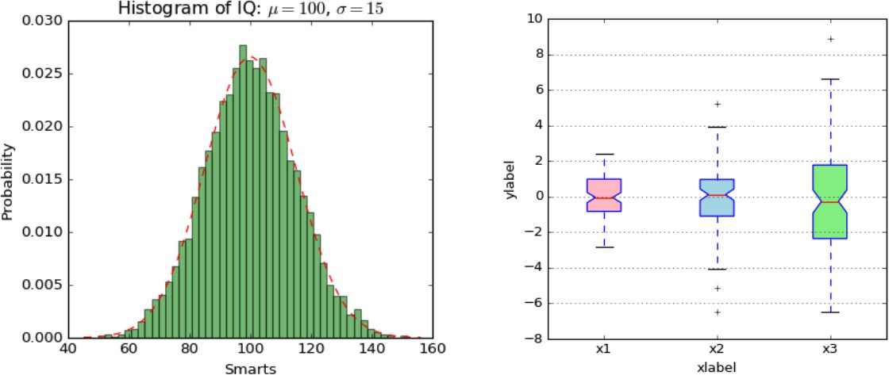
Data visualization
Very important in Data Analysis Explore data
Report insights

Slide 43
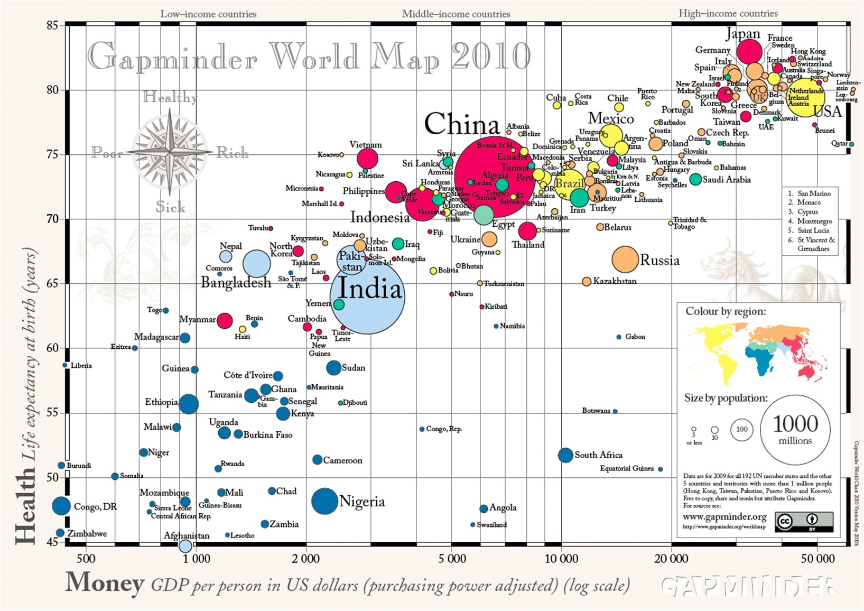
¹ Source: GapMinder, Wealth and Health of Nations

Slide 44
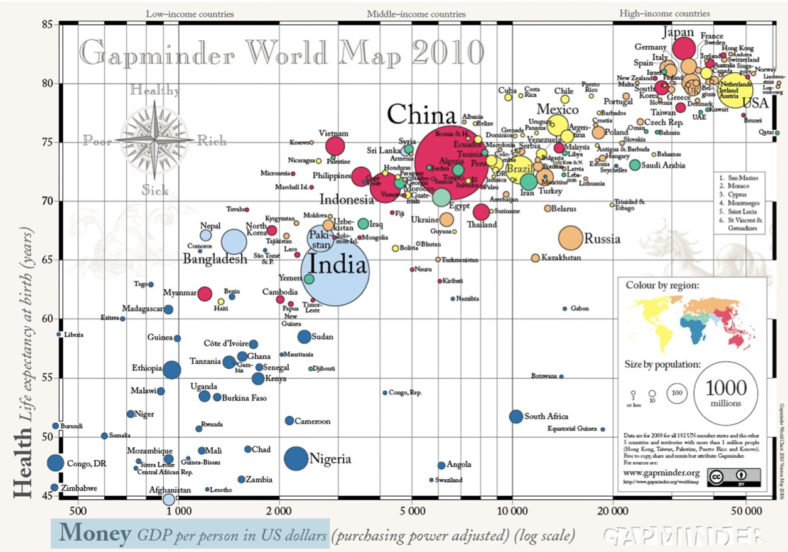
¹ Source: GapMinder, Wealth and Health of Nations

Slide 45
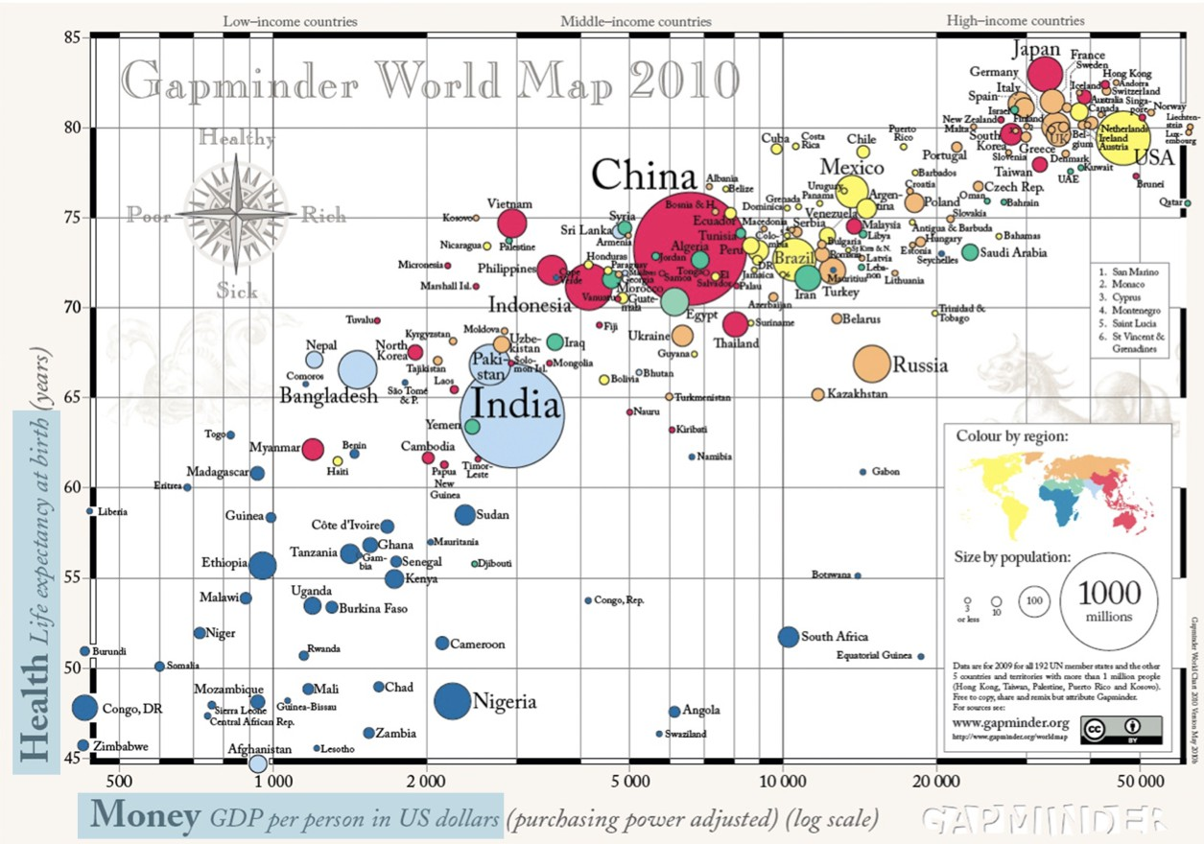
¹ Source: GapMinder, Wealth and Health of Nations

Slide 46
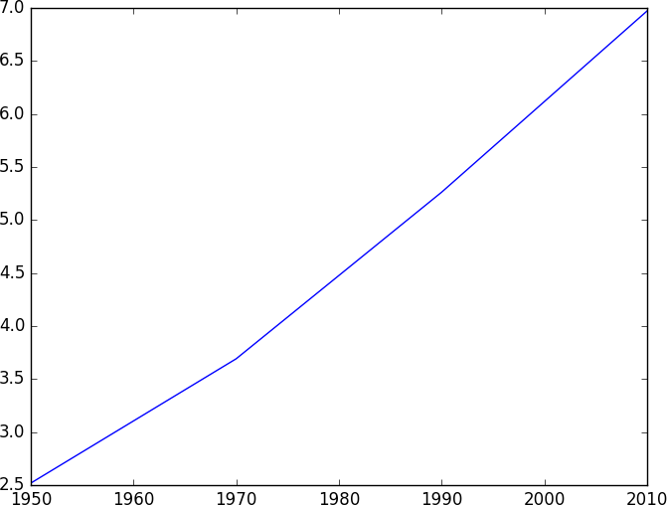
Matplotlib
matplotlib.pyplot plt year = [1950, 1970, 1990, 2010]
pop = [2.519, 3.692, 5.263, 6.972]
plt.plot(year, pop) plt.show()

Slide 47
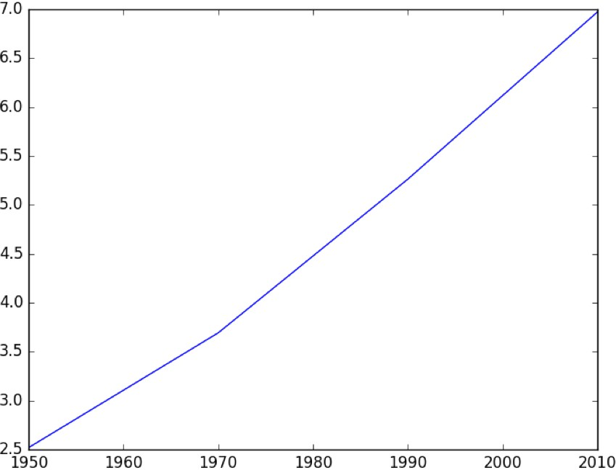
Matplotlib

Slide 48
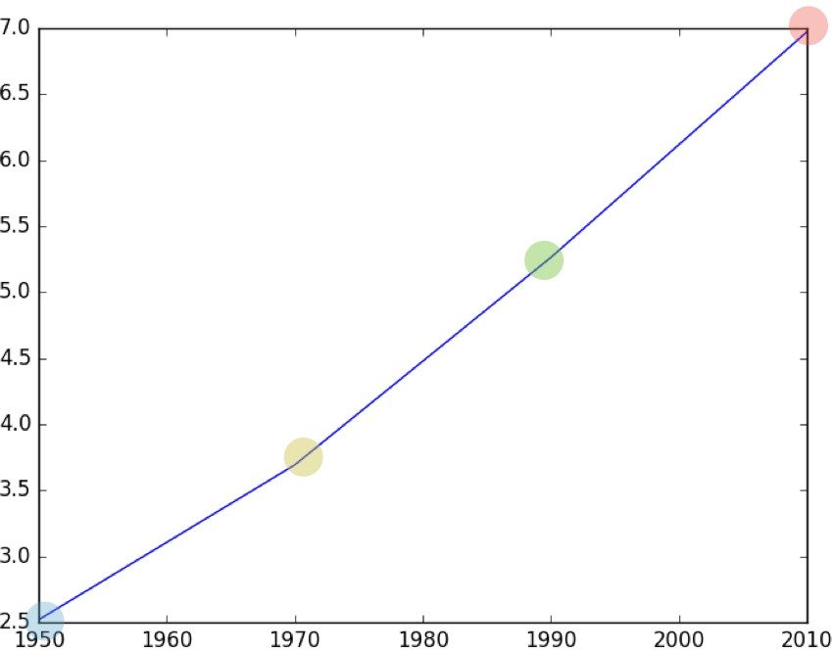
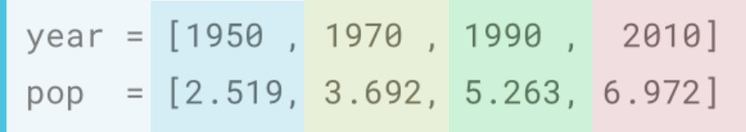
Matplotlib

Slide 49
Scatter plot
matplotlib.pyplot plt year = [1950, 1970, 1990, 2010]
pop = [2.519, 3.692, 5.263, 6.972]
plt.plot(year, pop) plt.show()

Slide 50
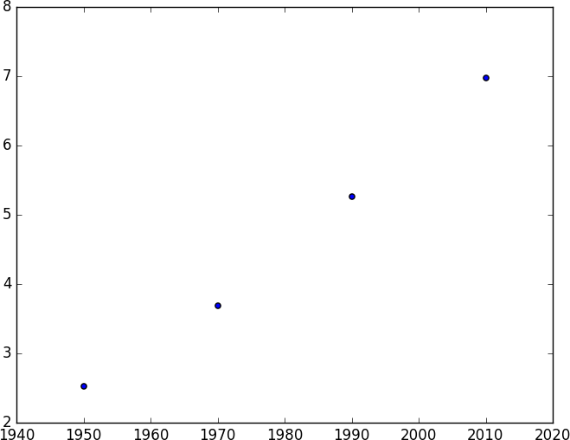
Scatter plot
matplotlib.pyplot plt year = [1950, 1970, 1990, 2010]
pop = [2.519, 3.692, 5.263, 6.972]
plt.scatter(year, pop) plt.show()

Slide 51
Histogram
P Y T H O N
Zakaria Ahmed
Omar Mohsen
Bassant Adel

Slide 52
Histogram
Explore dataset
Get idea about distribution

Slide 53
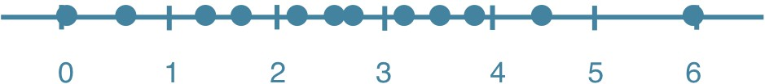
Histogram
Explore dataset
Get idea about distribution

Slide 54
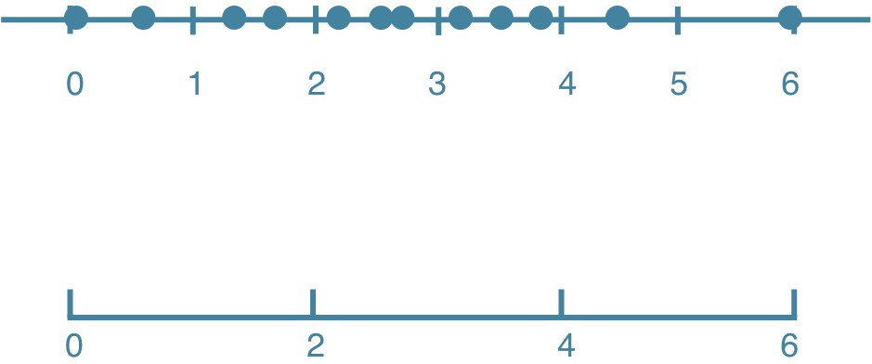
Histogram
Explore dataset
Get idea about distribution

Slide 55
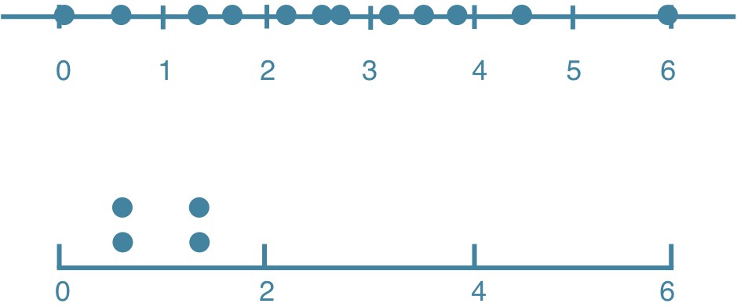
Histogram
Explore dataset
Get idea about distribution

Slide 56
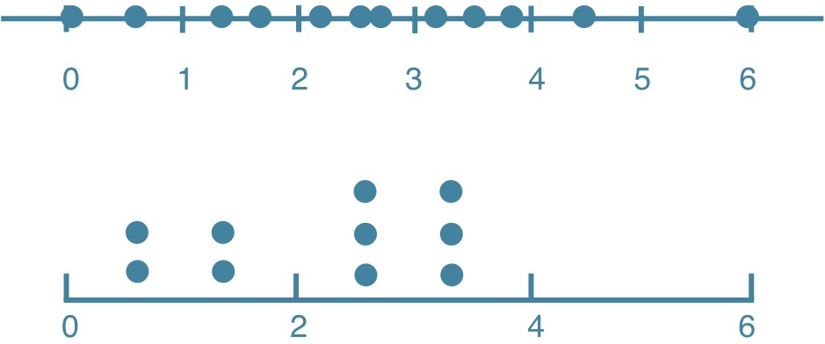
Histogram
Explore dataset
Get idea about distribution

Slide 57
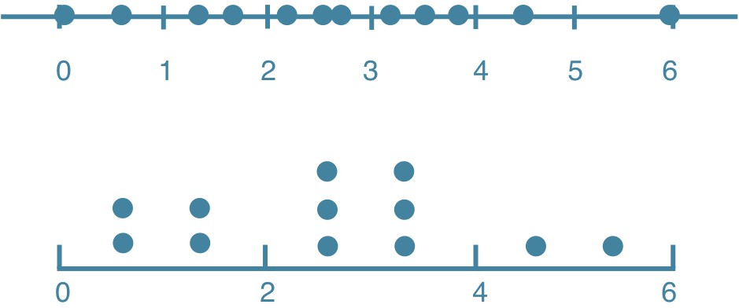
Histogram
Explore dataset
Get idea about distribution

Slide 58
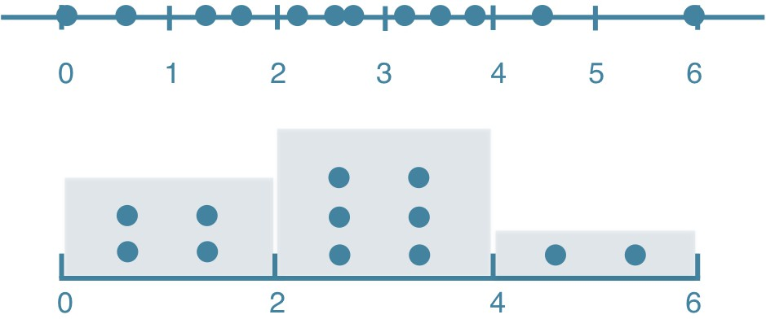
Histogram
Explore dataset
Get idea about distribution

Slide 59
Matplotlib
matplotlib.pyplot
plt
help(plt.hist)
Help on function hist in module matplotlib.pyplot:
hist(x, bins=None, range=None, density=False, weights=None, cumulative=False, bottom=None, histtype='bar', align='mid', orientation='vertical', rwidth=None, log=False, color=None, label=None, stacked=False, *, data=None, **kwargs)
Plot a histogram.
Compute and draw the histogram of *x*. The return value is a tuple (*n*, *bins*, *patches*) or ([*n0*, *n1*, ...],
*bins*, [*patches0*, *patches1*, ...]) if the input contains multiple data.

Slide 60
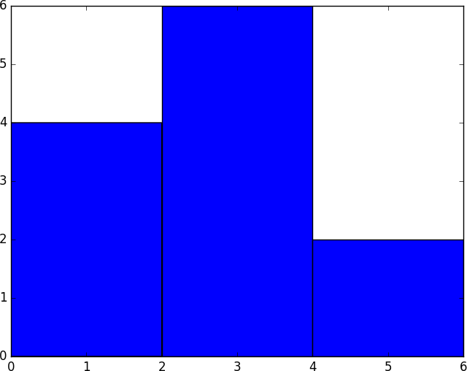
Matplotlib example
values = [0,0.6,1.4,1.6,2.2,2.5,2.6,3.2,3.5,3.9,4.2,6]
plt.hist(values, bins=3) plt.show()

Slide 61
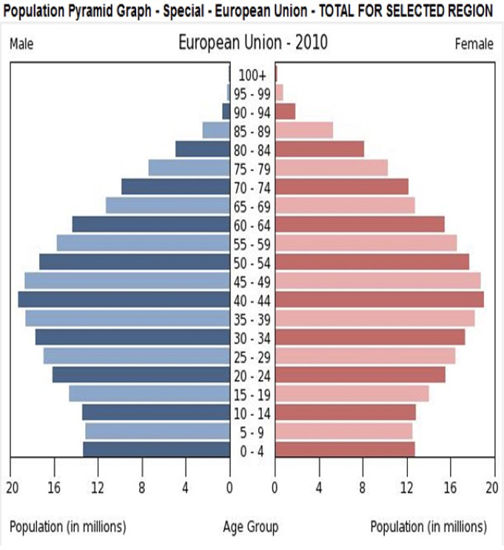
Population pyramid

Slide 62
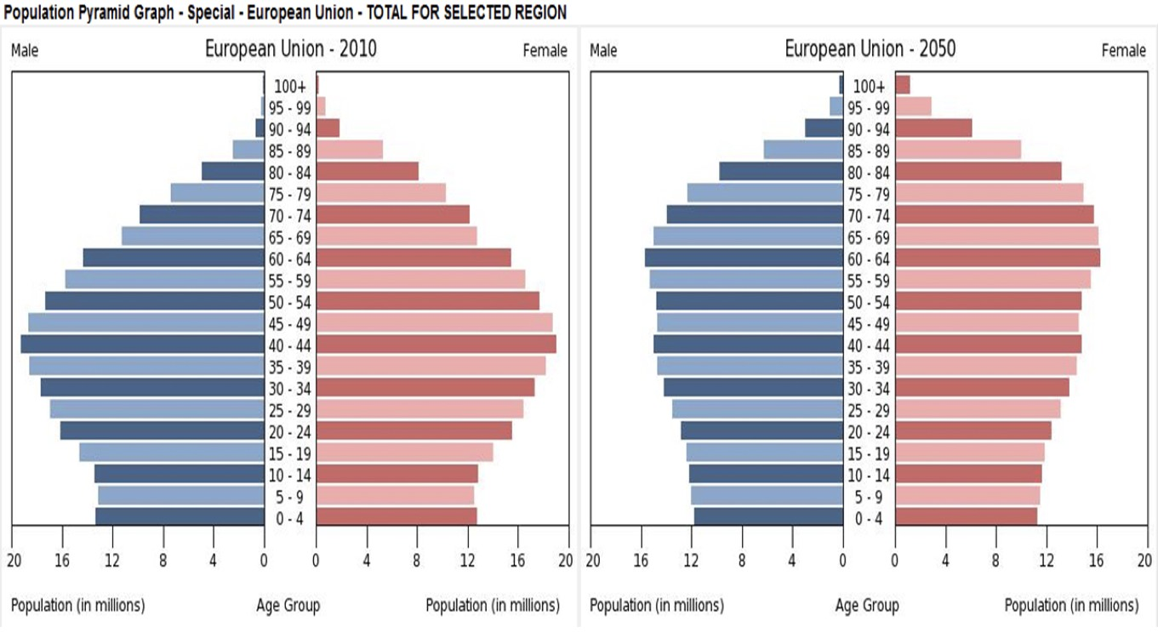
Population pyramid

Slide 63
Customization
P Y T H O N
Zakaria Ahmed
Omar Mohsen
Bassant Adel

Slide 64
Data visualization
Many options Different plot types
Many customizations Choice depends on
Data
Story you want to tell

Slide 65
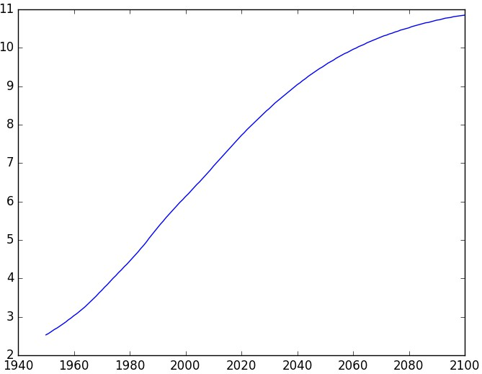
Basic plot
population.py
matplotlib.pyplot plt year = [1950, 1951, 1952, ..., 2100]
pop = [2.538, 2.57, 2.62, ..., 10.85]
plt.plot(year, pop) plt.show()

Slide 66
Axis labels
population.py
matplotlib.pyplot plt year = [1950, 1951, 1952, ..., 2100]
pop = [2.538, 2.57, 2.62, ..., 10.85]
plt.plot(year, pop)
plt.xlabel('Year') plt.ylabel('Population')
plt.show()

Slide 67
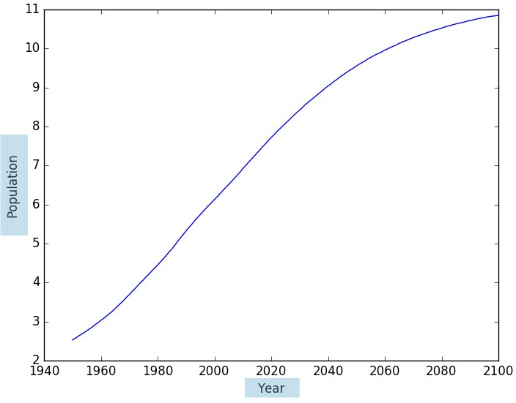
Axis labels
population.py
matplotlib.pyplot plt year = [1950, 1951, 1952, ..., 2100]
pop = [2.538, 2.57, 2.62, ..., 10.85]
plt.plot(year, pop)
plt.xlabel('Year') plt.ylabel('Population')
plt.show()

Slide 68
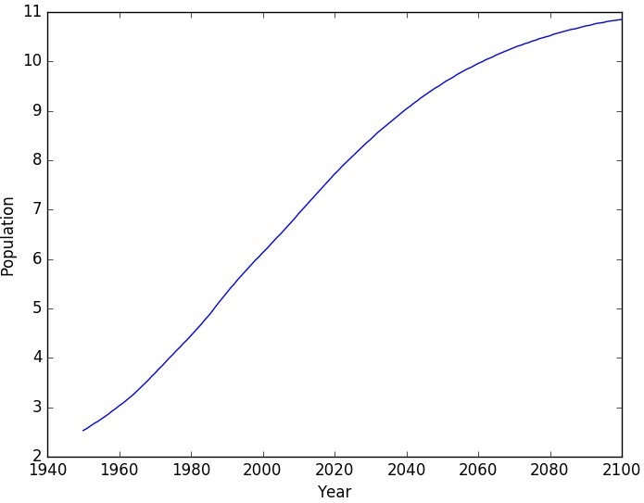
Title
population.py
matplotlib.pyplot plt year = [1950, 1951, 1952, ..., 2100]
pop = [2.538, 2.57, 2.62, ..., 10.85]
plt.plot(year, pop)
plt.xlabel('Year') plt.ylabel('Population') plt.title('World Population Projections')
plt.show()

Slide 69
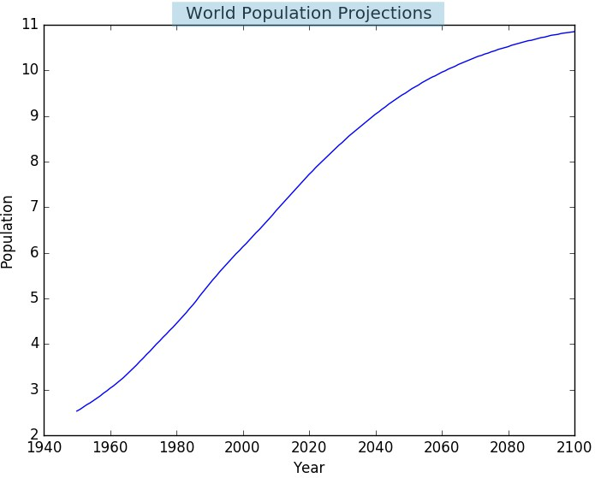
Title
population.py
matplotlib.pyplot plt year = [1950, 1951, 1952, ..., 2100]
pop = [2.538, 2.57, 2.62, ..., 10.85]
plt.plot(year, pop)
plt.xlabel('Year') plt.ylabel('Population') plt.title('World Population Projections')
plt.show()

Slide 70
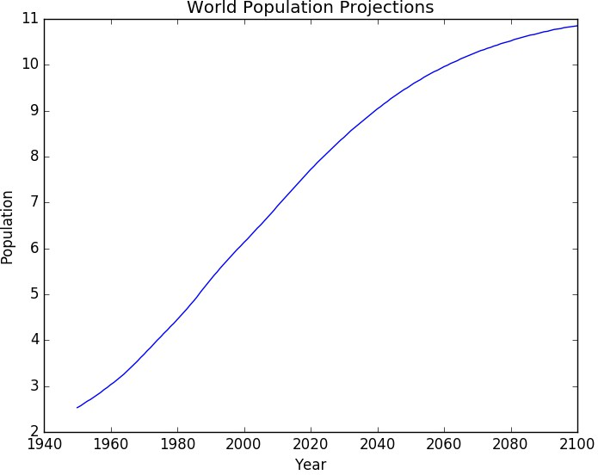
Ticks
population.py
matplotlib.pyplot plt year = [1950, 1951, 1952, ..., 2100]
pop = [2.538, 2.57, 2.62, ..., 10.85]
plt.plot(year, pop)
plt.xlabel('Year') plt.ylabel('Population') plt.title('World Population Projections') plt.yticks([0, 2, 4, 6, 8, 10])
plt.show()

Slide 71
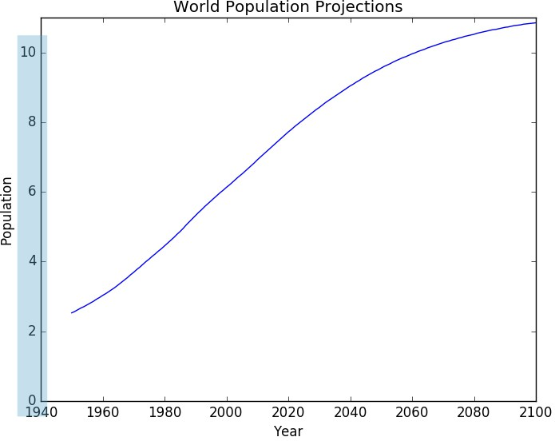
Ticks
population.py
matplotlib.pyplot plt year = [1950, 1951, 1952, ..., 2100]
pop = [2.538, 2.57, 2.62, ..., 10.85]
plt.plot(year, pop)
plt.xlabel('Year') plt.ylabel('Population') plt.title('World Population Projections') plt.yticks([0, 2, 4, 6, 8, 10])
plt.show()

Slide 72
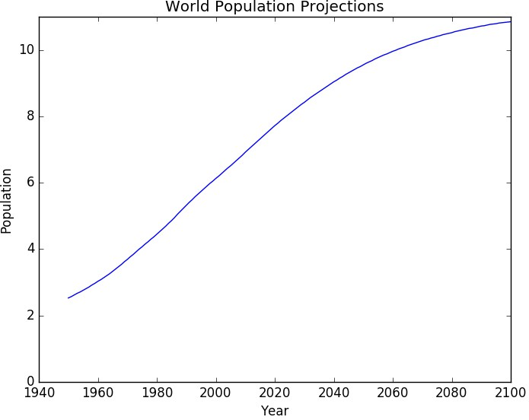
Ticks (2)
population.py
matplotlib.pyplot plt year = [1950, 1951, 1952, ..., 2100]
pop = [2.538, 2.57, 2.62, ..., 10.85]
plt.plot(year, pop)
plt.xlabel('Year') plt.ylabel('Population')
plt.title('World Population Projections') plt.yticks([0, 2, 4, 6, 8, 10],
['0', '2B', '4B', '6B', '8B', '10B'])
plt.show()

Slide 73
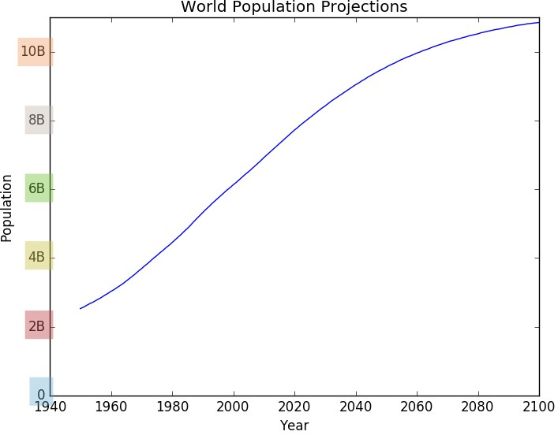
Ticks (2)
population.py
matplotlib.pyplot plt year = [1950, 1951, 1952, ..., 2100]
pop = [2.538, 2.57, 2.62, ..., 10.85]
plt.plot(year, pop)
plt.xlabel('Year') plt.ylabel('Population')
plt.title('World Population Projections') plt.yticks([0, 2, 4, 6, 8, 10],
['0', '2B', '4B', '6B', '8B', '10B'])
plt.show()

Slide 74
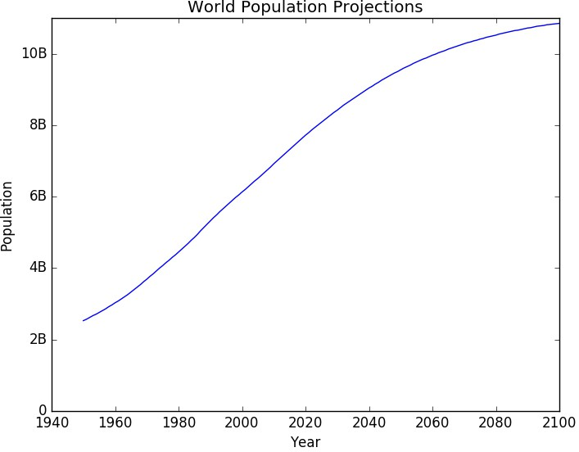
Add historical data
population.py
matplotlib.pyplot plt year = [1950, 1951, 1952, ..., 2100]
pop = [2.538, 2.57, 2.62, ..., 10.85]
# Add more data
year = [1800, 1850, 1900] + year
pop = [1.0, 1.262, 1.650] + pop
plt.plot(year, pop)
plt.xlabel('Year') plt.ylabel('Population')
plt.title('World Population Projections') plt.yticks([0, 2, 4, 6, 8, 10],
['0', '2B', '4B', '6B', '8B', '10B'])
plt.show()

Slide 75
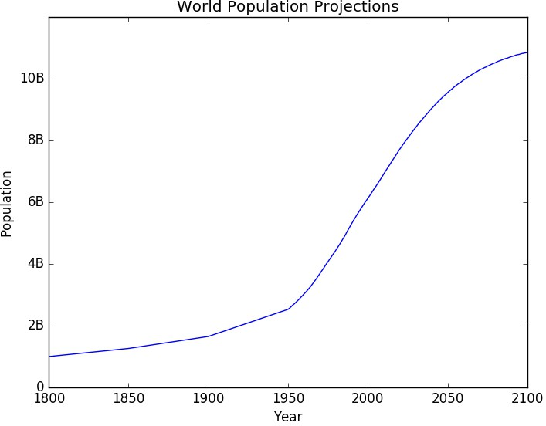
Add historical data
population.py
matplotlib.pyplot plt year = [1950, 1951, 1952, ..., 2100]
pop = [2.538, 2.57, 2.62, ..., 10.85]
# Add more data
year = [1800, 1850, 1900] + year
pop = [1.0, 1.262, 1.650] + pop
plt.plot(year, pop)
plt.xlabel('Year') plt.ylabel('Population')
plt.title('World Population Projections') plt.yticks([0, 2, 4, 6, 8, 10],
['0', '2B', '4B', '6B', '8B', '10B'])
plt.show()

Slide 76
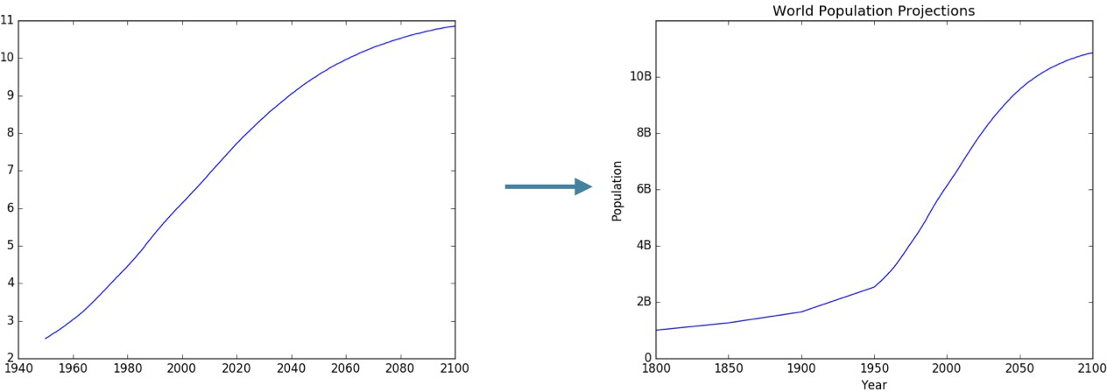
Before vs. after

